Slide 1
Process Portfolio.

Slide 2
Developing Ideas/Themes
In my senior year of art I was able to discover my theme of depression, I decided to experiment with color and texture through different mediums. I went with the approach of using items I've never necessarily worked with and just went at it.

Slide 3
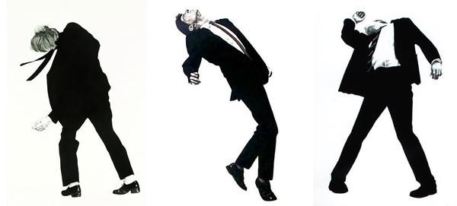
Art studies
The movement throughout this piece was inspired Robert Longo, where the black silhouettes was especially used as a way to express a feeling of empowerment and not being alone. Using a dark and colorful background, I create a sense of empowerment and never-ending space. The movement was inspired by the concept of having the black/white silhouettes to show the people in powerful positions because it would convey the message of power. With this art study I was also able to expand my mediums and create a theme of depression and isolation that could correlate to pieces I have done in the past.

Slide 4
Entering the idea of depression/isolation.
With entering into to the theme I focused on using singular items that showed no connection to any other item within the piece. I wanted to highlight the feelings a person with depression or has experienced isolation may have felt during that time and one of the feelings is loneliness. Many of my planning sketches were based upon the creepy tree that provides an uneasy feeling but also exemplifies the emotion of isolation

Slide 5
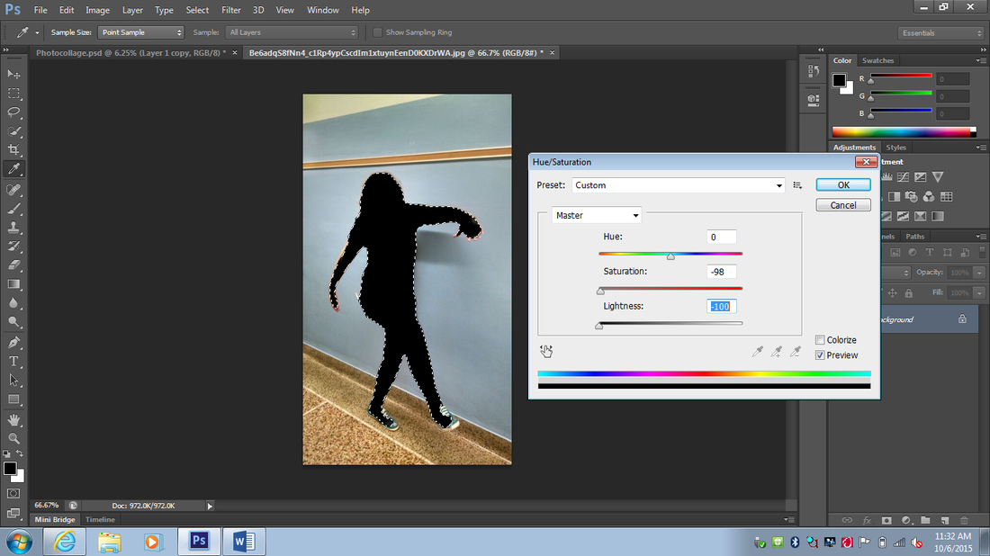
Skills,techniques, and Processes.
I used many methods that included block printing and PhotoShop. I chose block printing because it was easier to use the materials to create the fine lines and also create the dark and uneasy theme to fall under the isolation theme. I also used block printing to create a more clean and clear image of my piece. I used PhotoShop to manipulate images and personal photos I had taken to create a single object of focus like the black silhouette in the left corner.

Slide 6
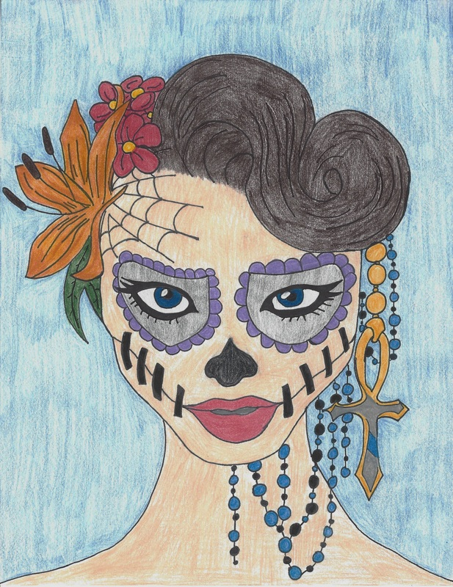
Transitioning to new Mediums
When I continued to create pieces under this theme I wanted to expand my use of mediums through drawing and using industrial pieces to create an organic compound. With the drawing medium I was able to use my skills to show a great amount of detail in the face and in the beading of the necklace. With using industrial objects I was able to obtain new skills on creating mixed media pieces and using what materials I had near me.

Slide 7
Experimental Processes

Slide 8
Gallery Visit

